Slide 1
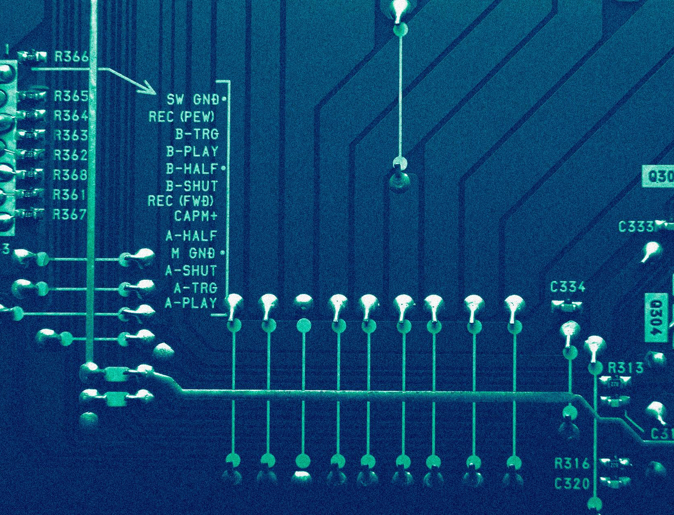
CS 513 Final Project
Diabetes Treatment Prediction
Aditi Gupta
David Laziuk
Michael Scoli
Group 5

Slide 2
Table of contents
0.1
1.3
0.2
1.4
1.1
1.5
1.2
1.6
2.0?
Goals
k-NN
Preprocessing
Logistic Regression
Naïve Bayes
Random Forest
Decision Tree
A-NN

Slide 3
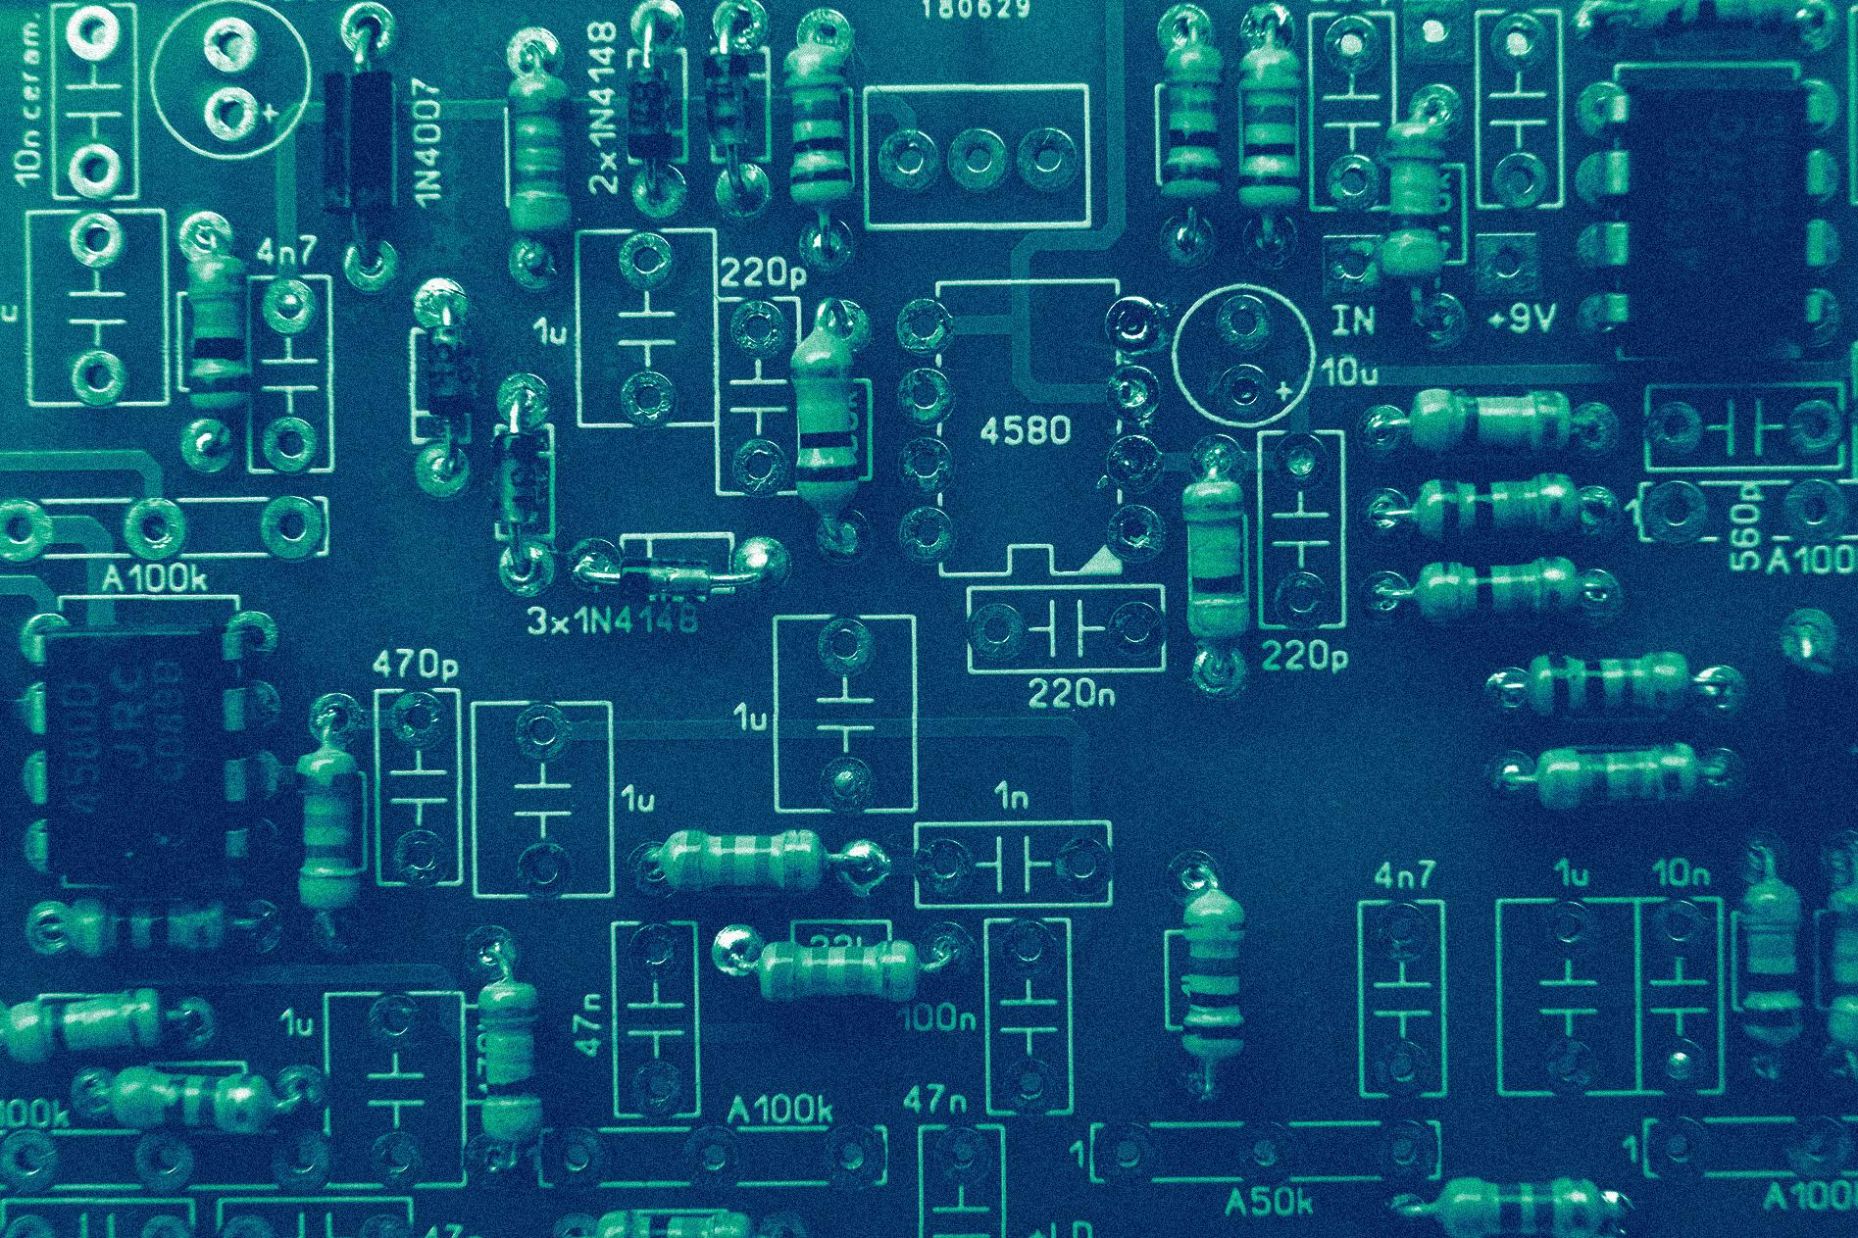
Goals
-
0.1

Slide 4
Problem Statement
Background
Diabetes is a chronic (long-lasting) health condition that affects how your body turns food into energy.
Problem
Diabetes is not only one of the top ten leading causes of death in the world, but also the 2nd most expensive chronic disease in the US (National Association for Biomedical Research)
Solution
Therefore, we want to classify a diabetic patient’s hospital readmission status with the ultimate goal of improving patient outcomes.

Slide 5
Overview of the Dataset
The data represents 10 years (1999-2008) of clinical care at 130 US hospitals
It includes over 50 features representing patient and hospital outcomes such as:
Race, Gender, Age, Weight, Admission Code
Number of ( Procedures, Medications, Diagnoses )
Time in Hospital, Medical Test Results, Diagnosis Codes, etc.
The target variable is “readmitted”, which contains three values: no readmission, a readmission in less than 30 days, and a readmission in more than 30 days.
The 3 target variables will be mapped to a binary classification:
No readmission (0) & readmission (1)

Slide 6
Preprocessing
-
0.2

Slide 7
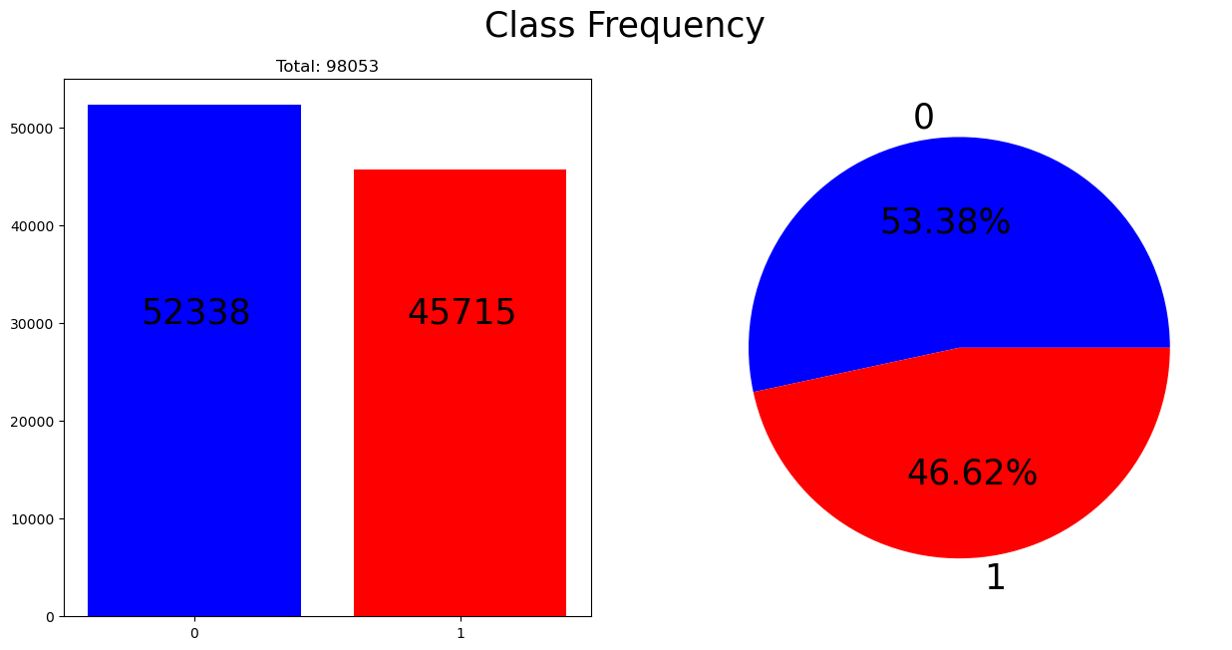
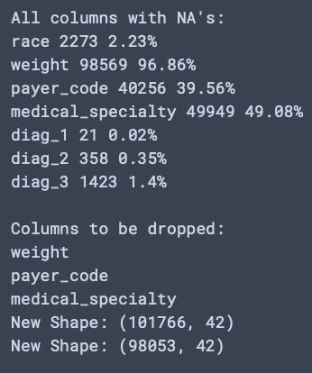
Data Manipulation & Drops
Map Class to (0,1) No->0 (<30 & >30)-> 1
Drop Irrelevant Features (e.g Patient Number)
Drop Columns with too many missing values
Drop Remaining Rows with NAs

Slide 8
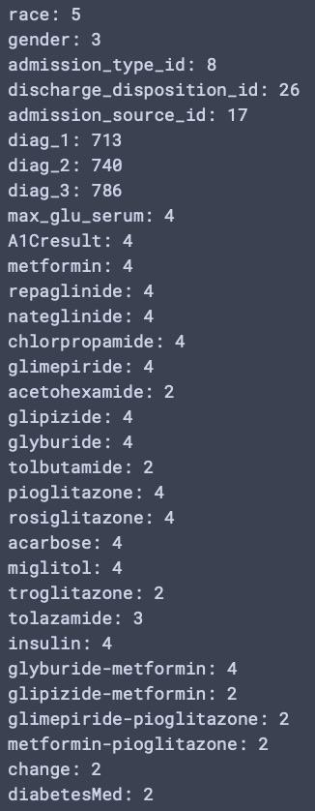
Encoding
42 to
~2400 Features!
(Bad)
42 to
~121 Features!
(Better)
Nominal (Unordered) Categorical Variables Need To Be Encoded
One-Hot
Binary
Nominal Count
Dog | Cat | Bird
1 | 0 | 0
0 | 1 | 0
0 | 0 | 1
Animal
Dog
Cat
Bird
Ordinal -> Numeric
Age Mapping
[0-10) -> 1
[10-20) -> 2
*
*
*
[80-90) -> 9
[90-100) -> 10
Animal
Dog
Cat
Bird
Animal01 | Animal02
0 | 1
1 | 0
1 | 1

Slide 9
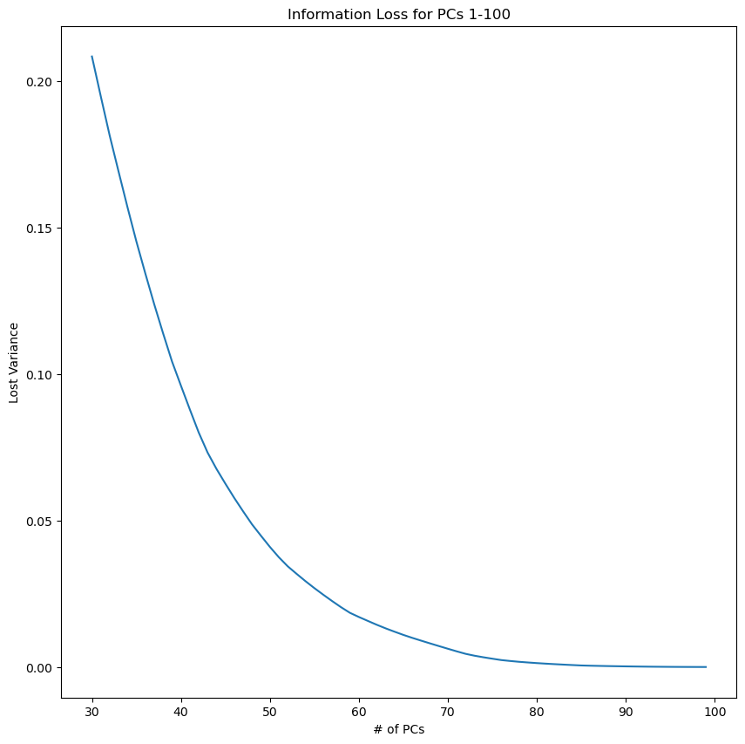
Normalization
Min-Max Normalization was used to fit numerical features into a [0,1] range
MMN is preferred as there are many categorical variables present
PCA?
For 75 PC’s, only 2.87% variance is lost
However,
Testing using Random Forest is significantly impacted.
Accuracy Score drops ~7.5%
Is this sacrifice worth it?

Slide 10
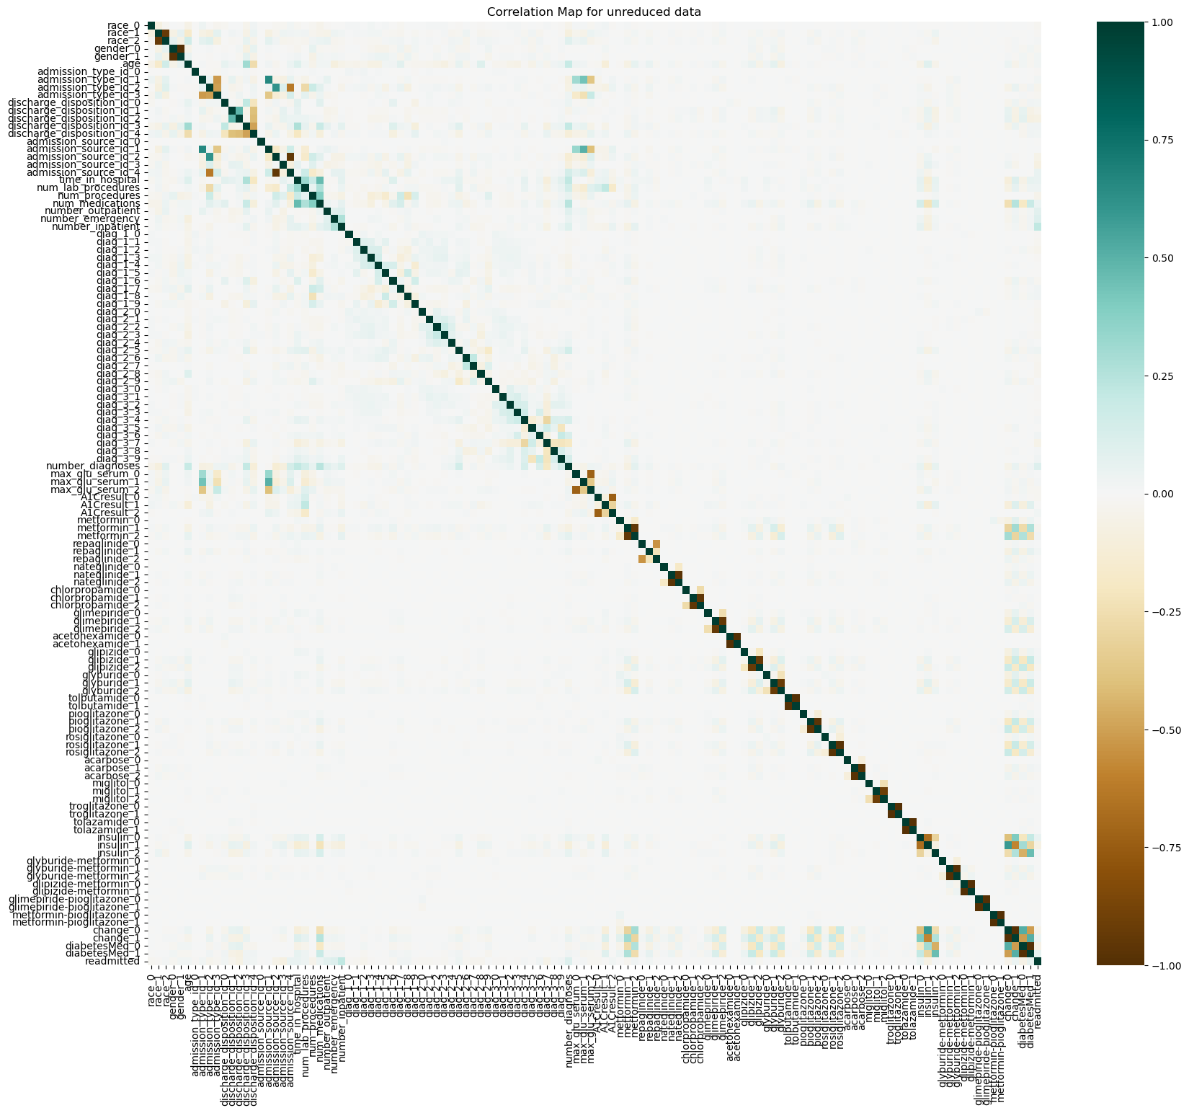
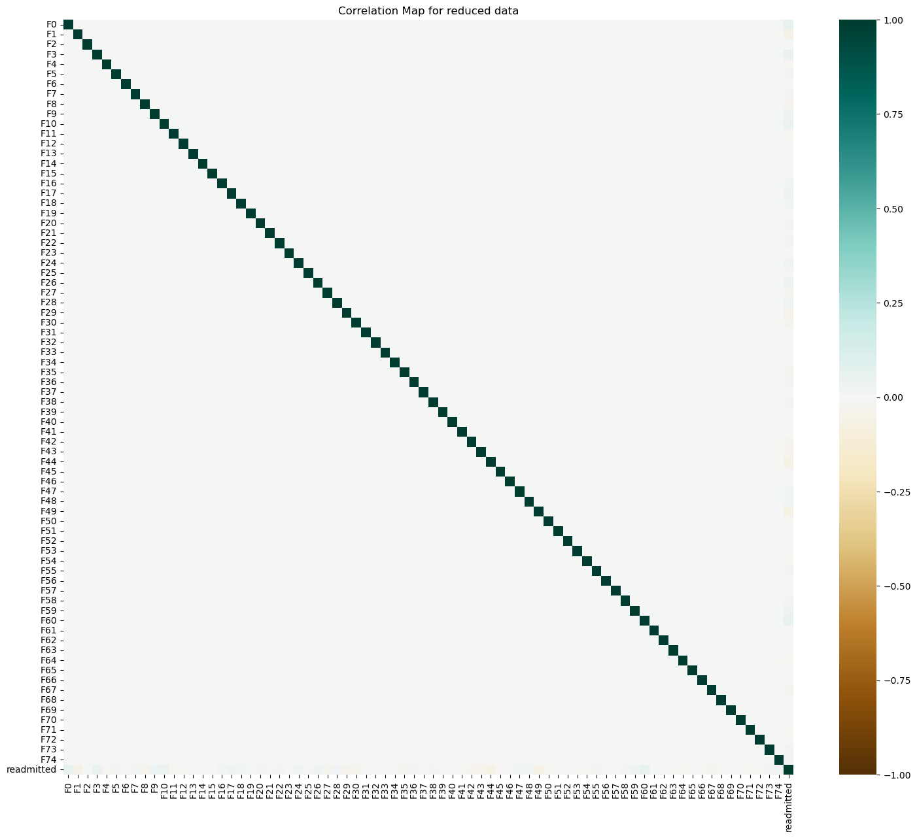
Additional EDA

Slide 11
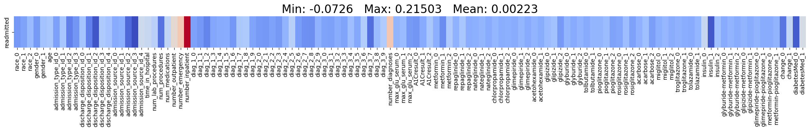
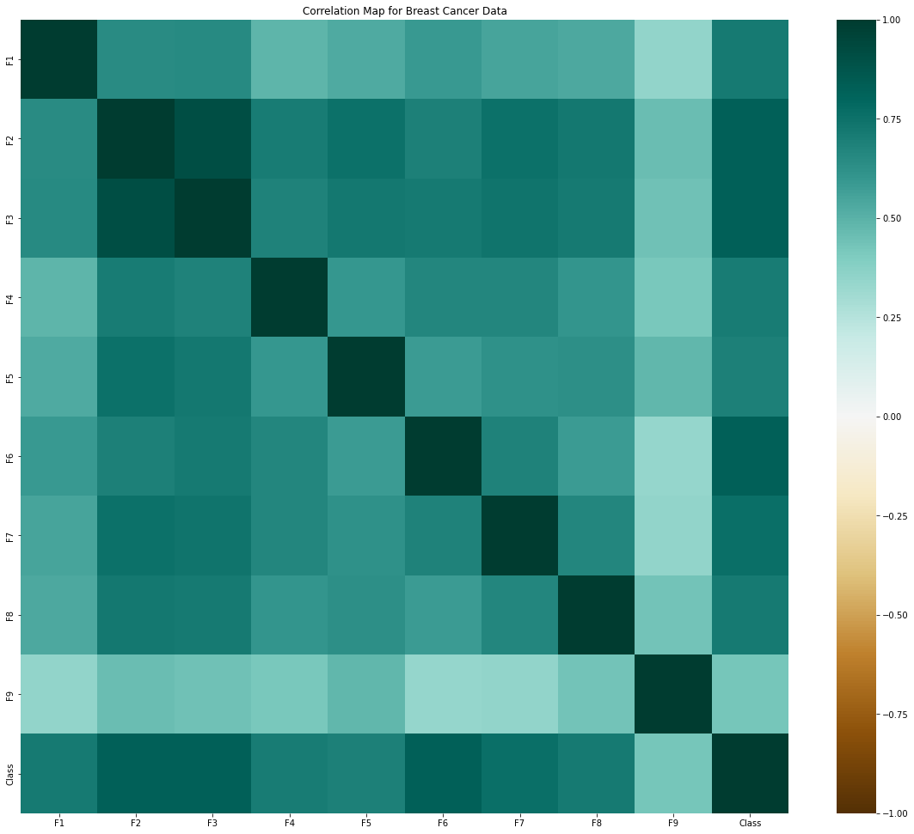
Additional EDA
Unreduced:
Reduced:
Does this mean anything?
Same EDA done on breast-cancer-wisconsin
dataset used for class assignments

Slide 12
Naïve Bayes
-
1.1

Slide 13
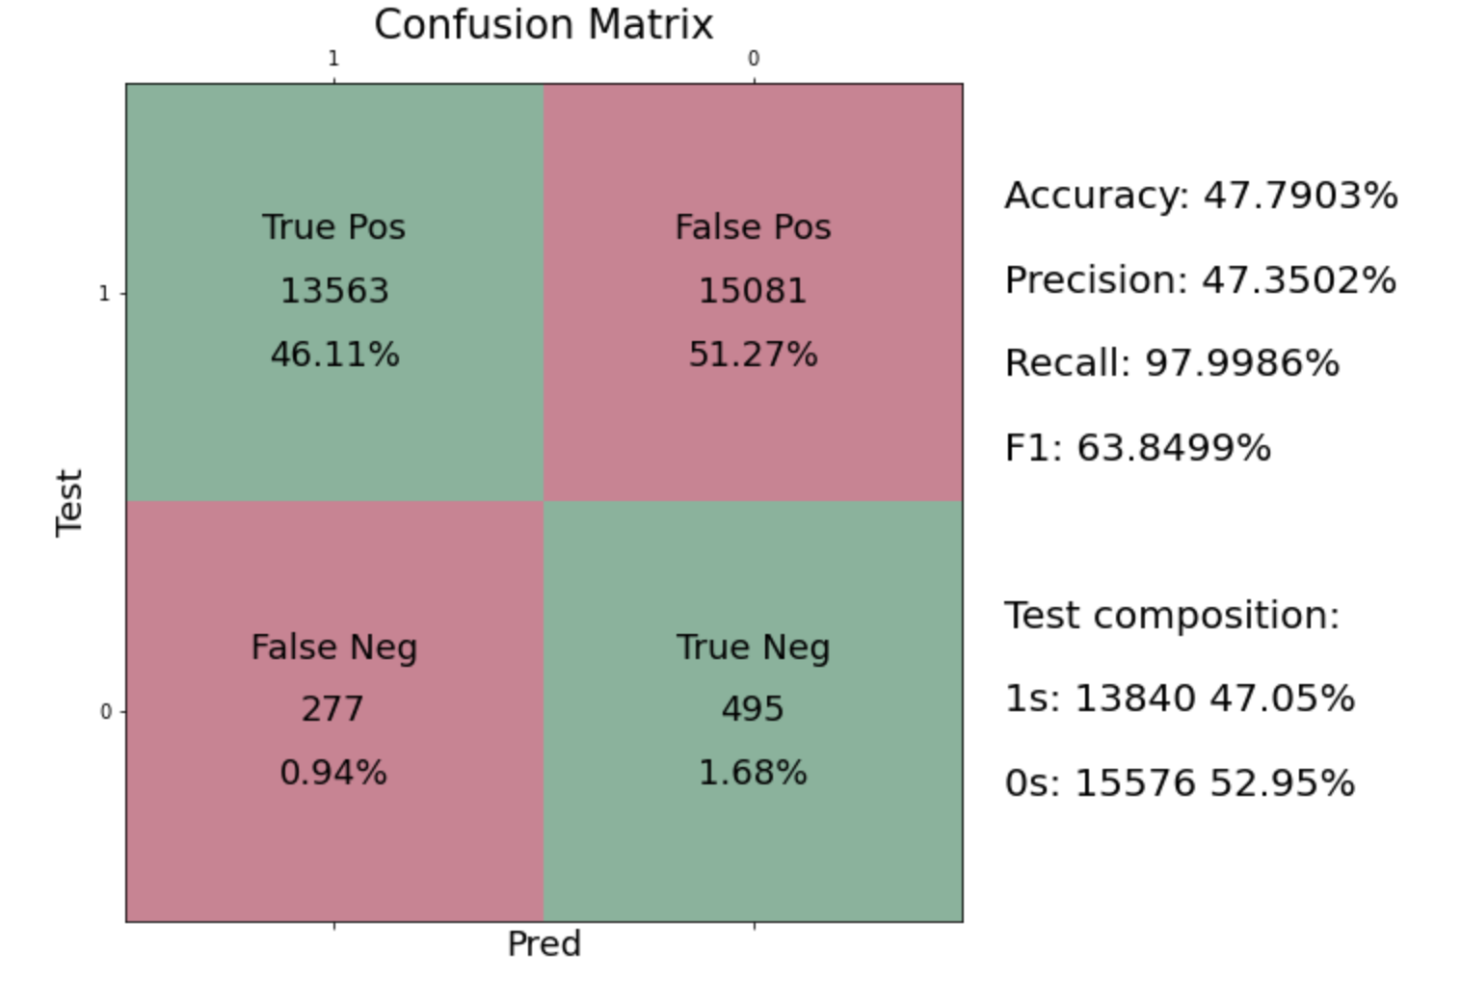
Naïve Bayes

Slide 14
Decision Tree
-
1.2

Slide 15
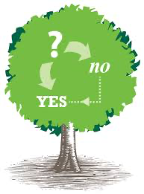
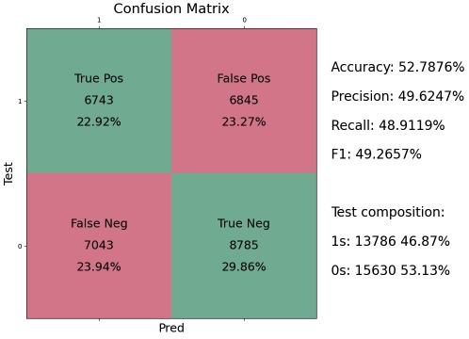
Decision Tree
Offers decent improvement over Naïve Bayes
Still could be beat by always predicting majority class (0)
Poor performance likely due to overfitting
Accuracy | Record
NB | .4779
DT | .5279

Slide 16
k-NN
1.3

Slide 17
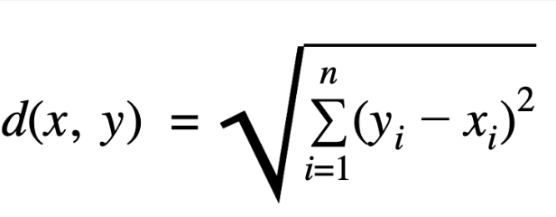
K Nearest Neighbor Classifier
KNN is one of the simplest supervised machine learning algorithm.
KNN classifies a data point based on how its neighbors are classified
It stores all available cases and classifies new cases based on a similarity measure, choosing the right value of K is a process called parameter tuning and its important for better accuracy.
K in KNN is a parameter that refers to the number of nearest neighbors to include in the majority voting process
To find the nearest neighbors, we will calculate Euclidean distance.

Slide 18
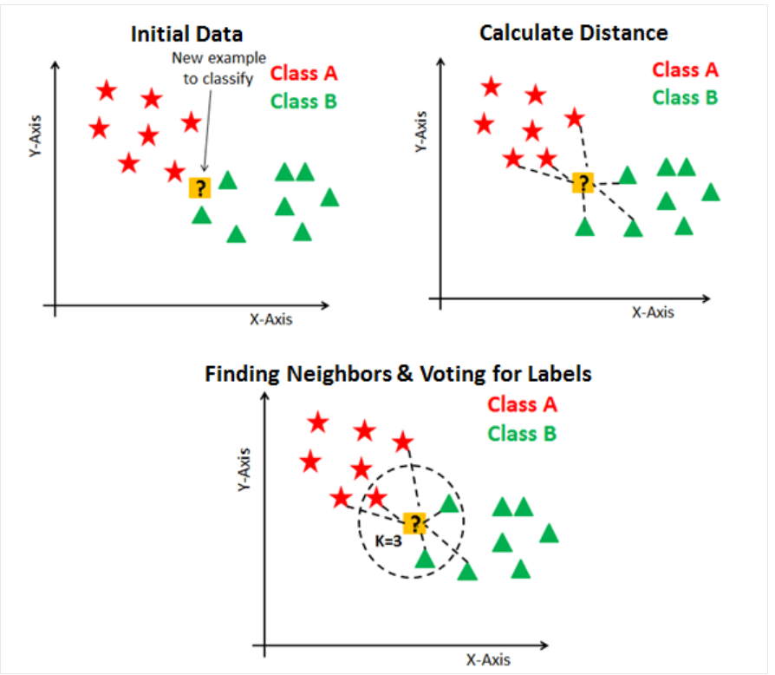
K Nearest Neighbor Classifier

Slide 19
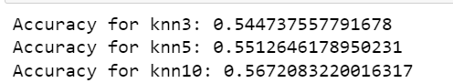
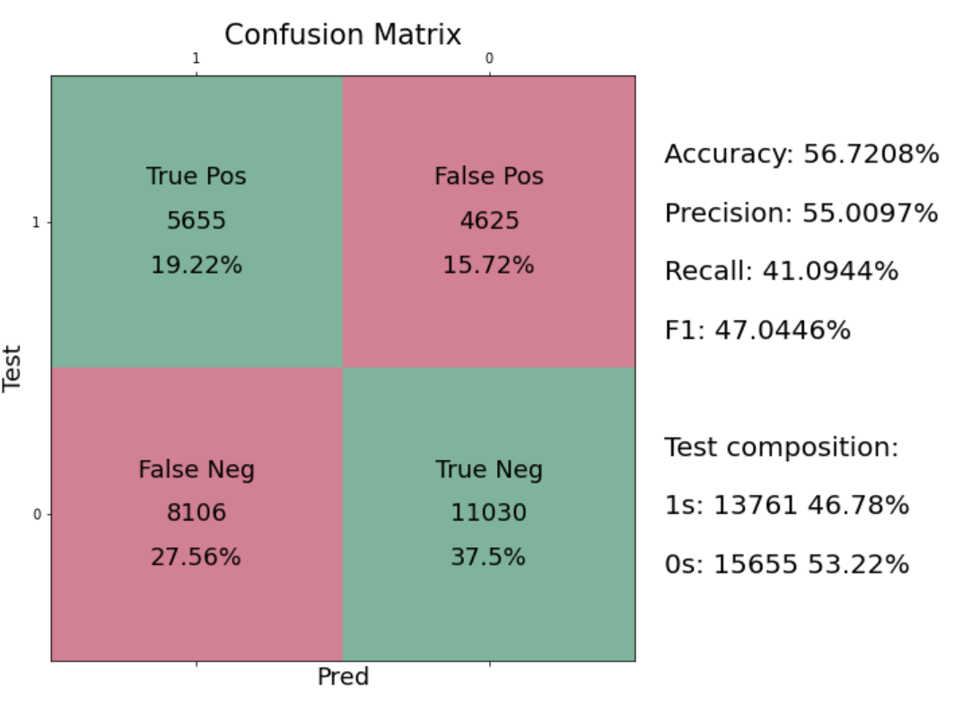
K Nearest Neighbor Classifier
Accuracy :
Confusion matrix :
Accuracy | Record
NB | .4779
DT | .5279
kNN | .5672

Slide 20
Logistic Regression
1.4

Slide 21
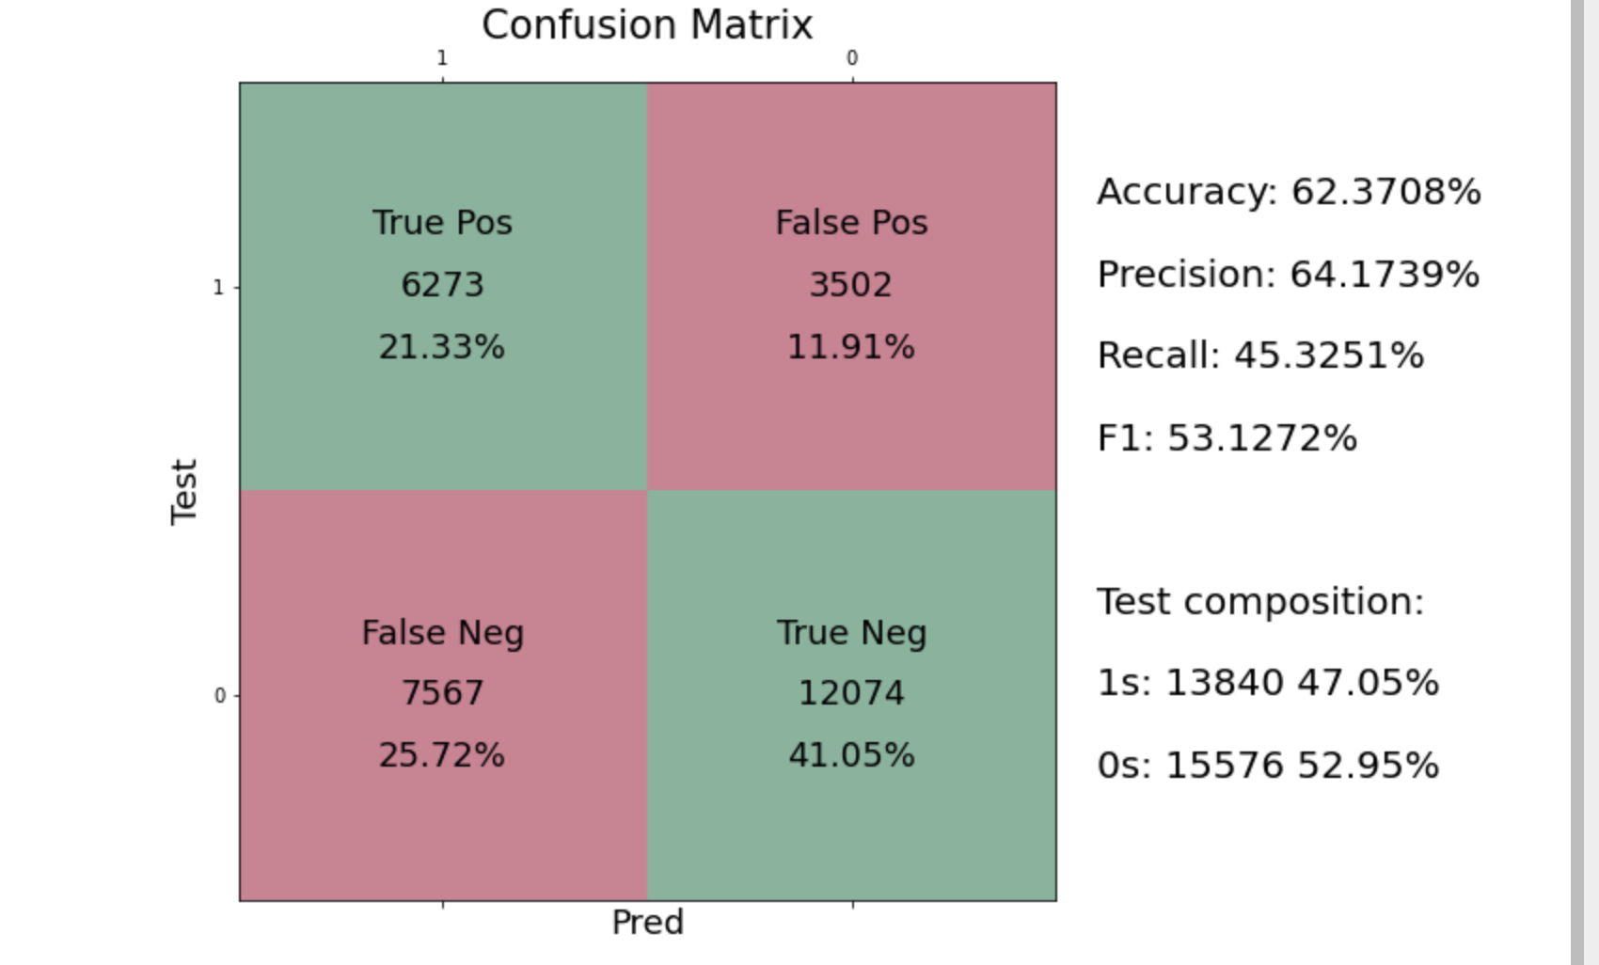
Logistic Regression
Accuracy | Record
NB | .4779
DT | .5279
kNN | .5672
L-R | .6237

Slide 22
Random Forest
1.5

Slide 23
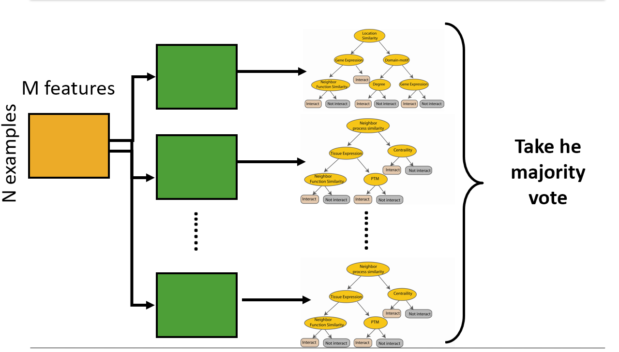
Random Forest Classifier
Decision trees are prone to overfitting this means it is likely the predictions will be too closely linked to the data we have and will not predict effectively on new data.
A major step to avoiding this issue is instead using random forest classifier.
Random forest are collections of decision trees. Each tree makes its own prediction and those predictions are then aggregated into a final prediction either by votes.

Slide 24
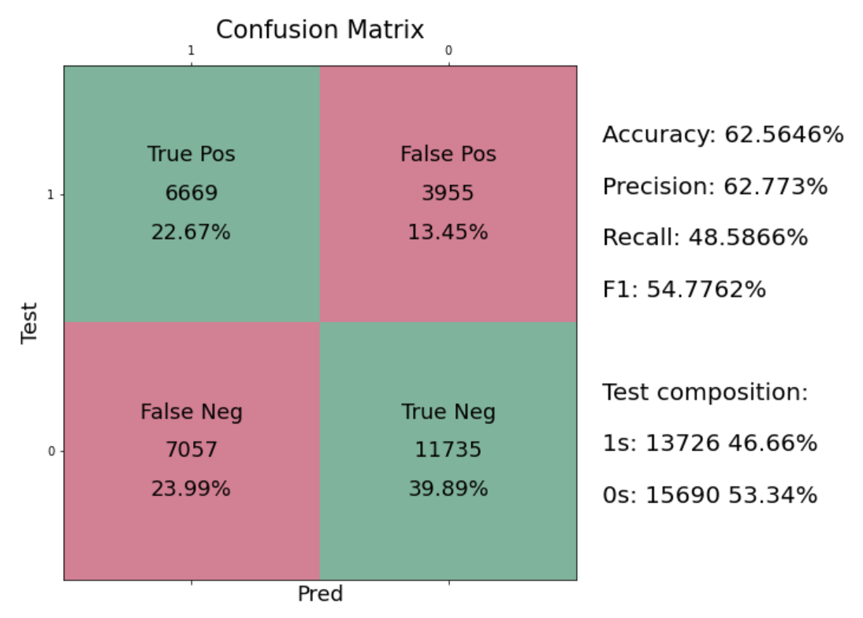
Random forest Classifier
Accuracy : 0.6256459069893935
Random guessing accuracy: 0.4983682349741637
Confusion matrix :
Accuracy | Record
NB | .4779
DT | .5279
kNN | .5672
L-R | .6237
RF | .6256

Slide 25
A-NN
-
1.6

Slide 26
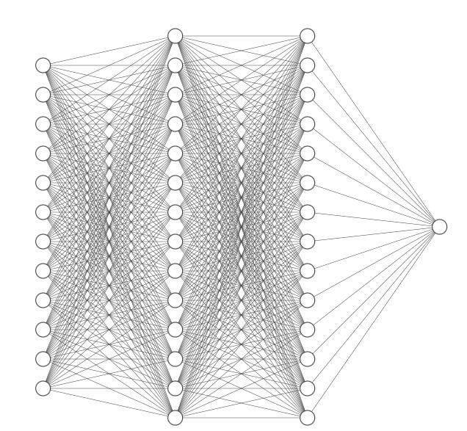
Architecture
140 ReLU
140 ReLU
PyTorch Framework
2 Hidden Layers with
140 nodes each
ReLU activation on all layers
Batch Normalization on all layers
Dropout:
20% on inputs
50% for hidden layers
121
ReLU
1

Slide 27
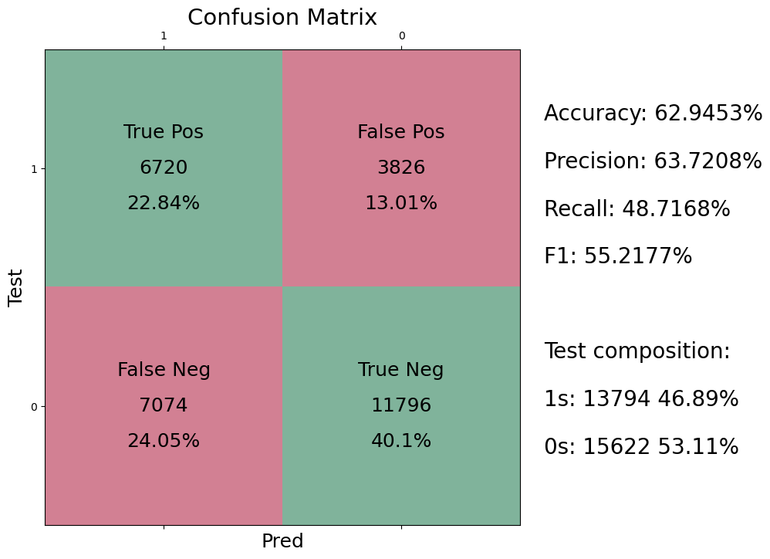

Results
Accuracy | Record
NB | .4779
DT | .5279
kNN | .5672
L-R | .6237
RF | .6256
ANN | .6295
Outperforms Traditional Models !

Slide 28
Bonus Round
-
2.0

Slide 29

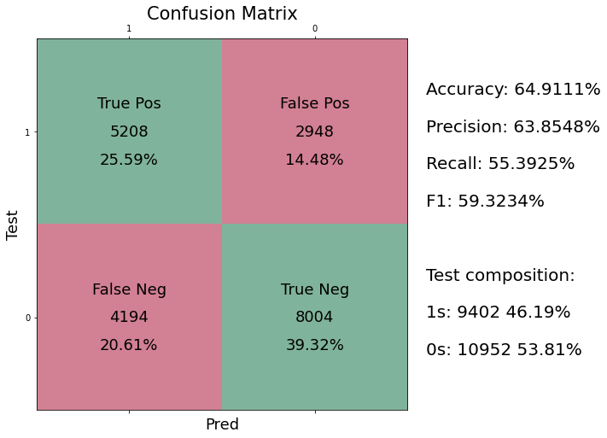
Auto-PyTorch
LGBM- Light Gradient Boosting Framework
Arguably superior to XGBoost
CBLearner- ?
Possibly relating to callbacks
Neural Network
Accuracy | Record
NB | .4779
DT | .5279
kNN | .5672
L-R | .6237
RF | .6256
ANN | .6295

Slide 30
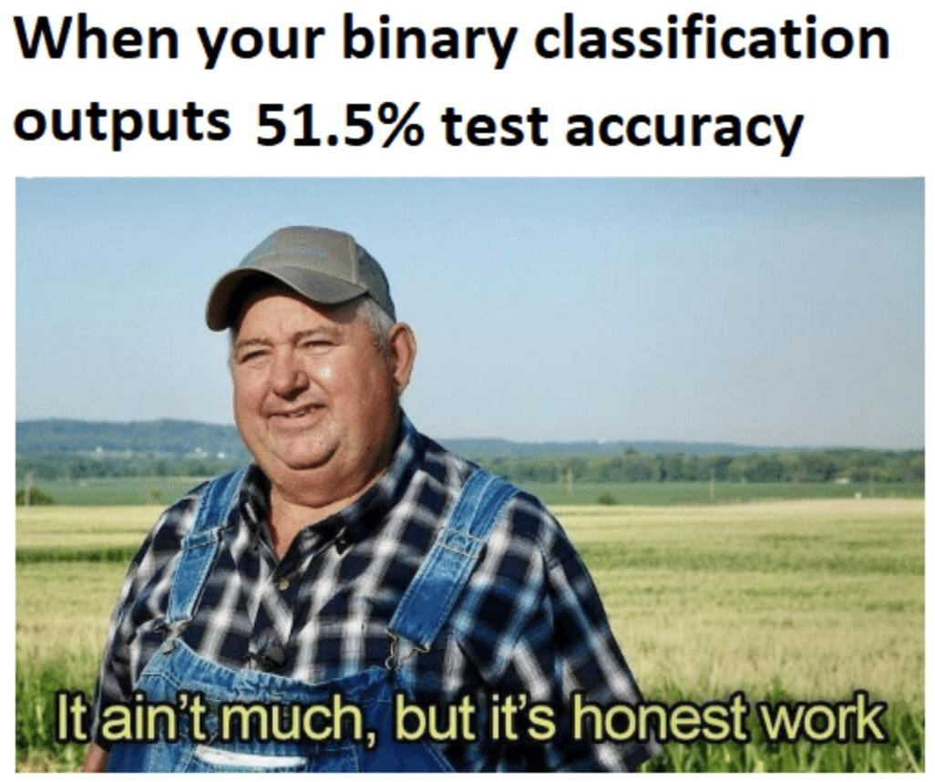
Thanks!

